Slide 1
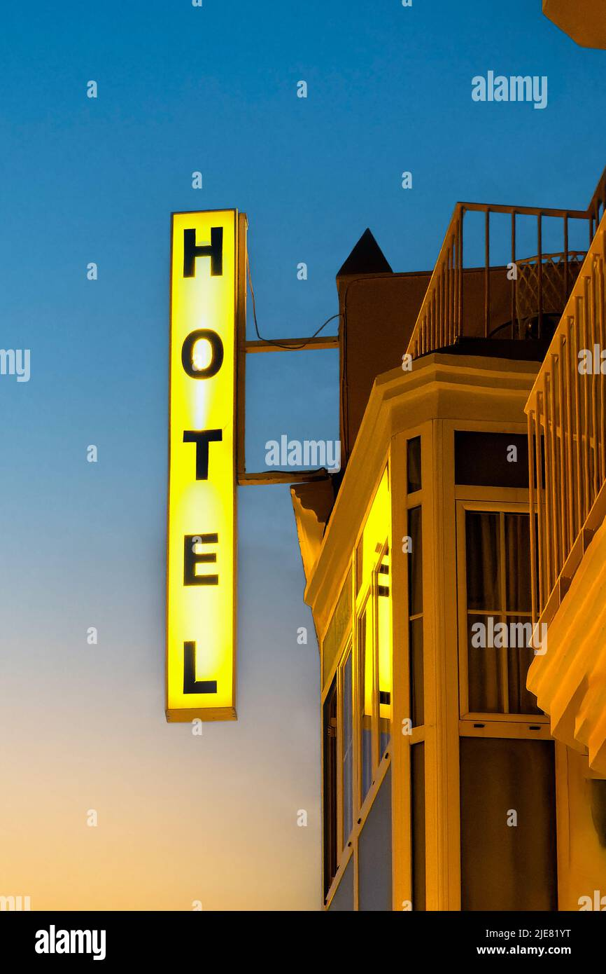
Hotel Review CLaSSIFICATION
DS-P-190
Mentor: Mr. Adhvaith Sir
BY GROUP: 2
Nikhil Rajput
Priyanshi Sharma
Saurabh Nimje
Atharv Chougule

Slide 2

Customer reviews on hotels are very important part of travel plan for people now a days. People
prefer to book such hotels which have high number of positive reviews. There are diﬀerent sources
to ﬁnd the reviews to get a better insight about the hotel’s reputation. Thus it can be said that
customer reviews plays an important part for business owners in order to improve their services.
In this project, sentiment analysis is performed on the basis of user reviews using three diﬀerent
classiﬁers. The classiﬁers used in this project are “Naive Bayes", "Random Forest” and “Support
Vector Machine”. The performance of these algorithms are assessed on two diﬀerent parameter
settings. The reviews are classiﬁed as “positive", "negative” labels.

Slide 3
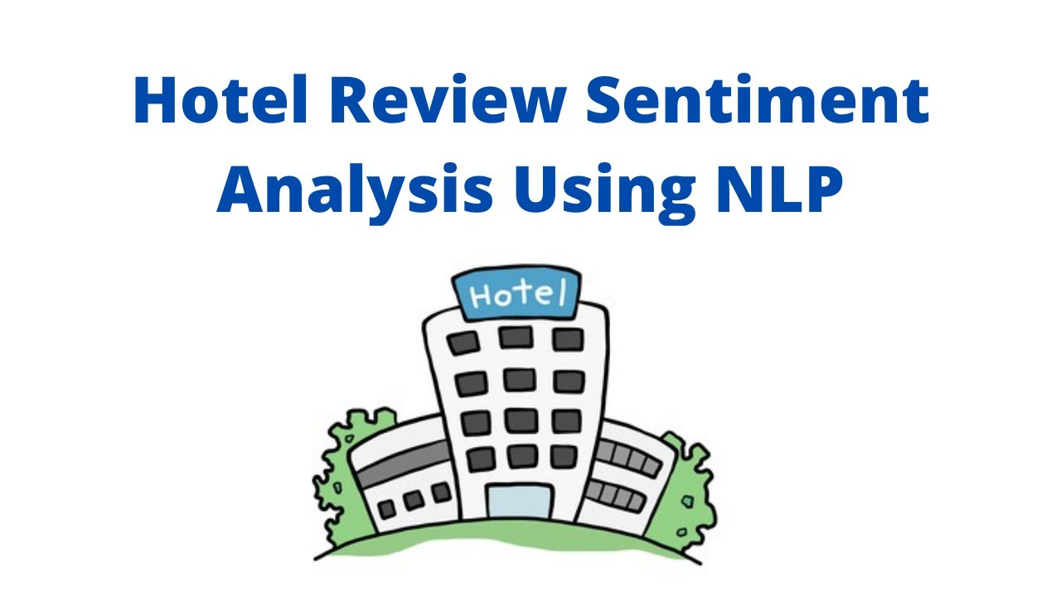
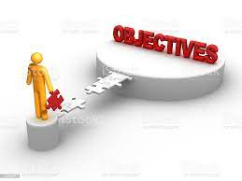
Objective:
Our goal is to examine how travellers are communicating their positive and negative experiences in online platforms for staying in a specific hotel and major objective is what are the attributes that travellers are considering while selecting a hotel. With this manager can understand which elements of their hotel influence more in forming a positive review or improves hotel brand image.

Slide 4

Business Problem
Project Flow
Data Summary
Data Pre-processing
Different Model Performance
Deployment
Challenges
Conclusion
Future Scope

Slide 5

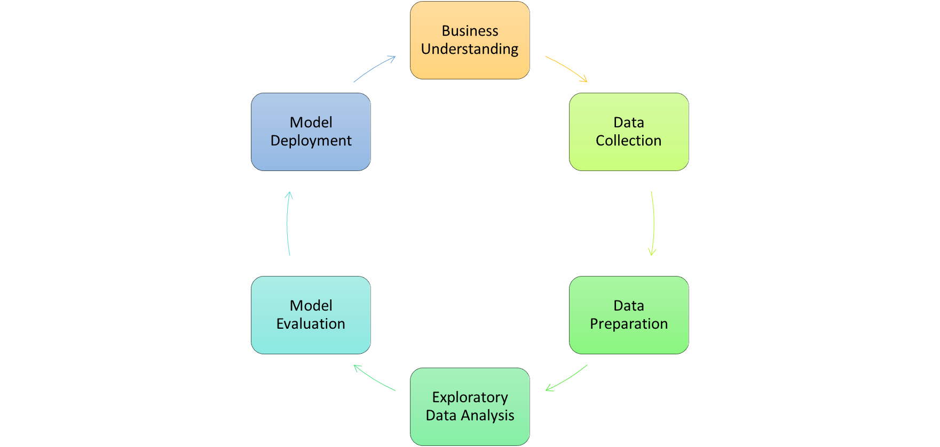

Slide 6
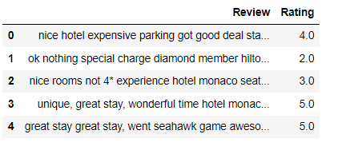
Data Summary
Dataset details:
The above dataset containing hotel reviews provided by client.
The Dataset contains 20,491 rows and 2 columns.
The Dataset does not have duplicate or missing values.

Slide 7
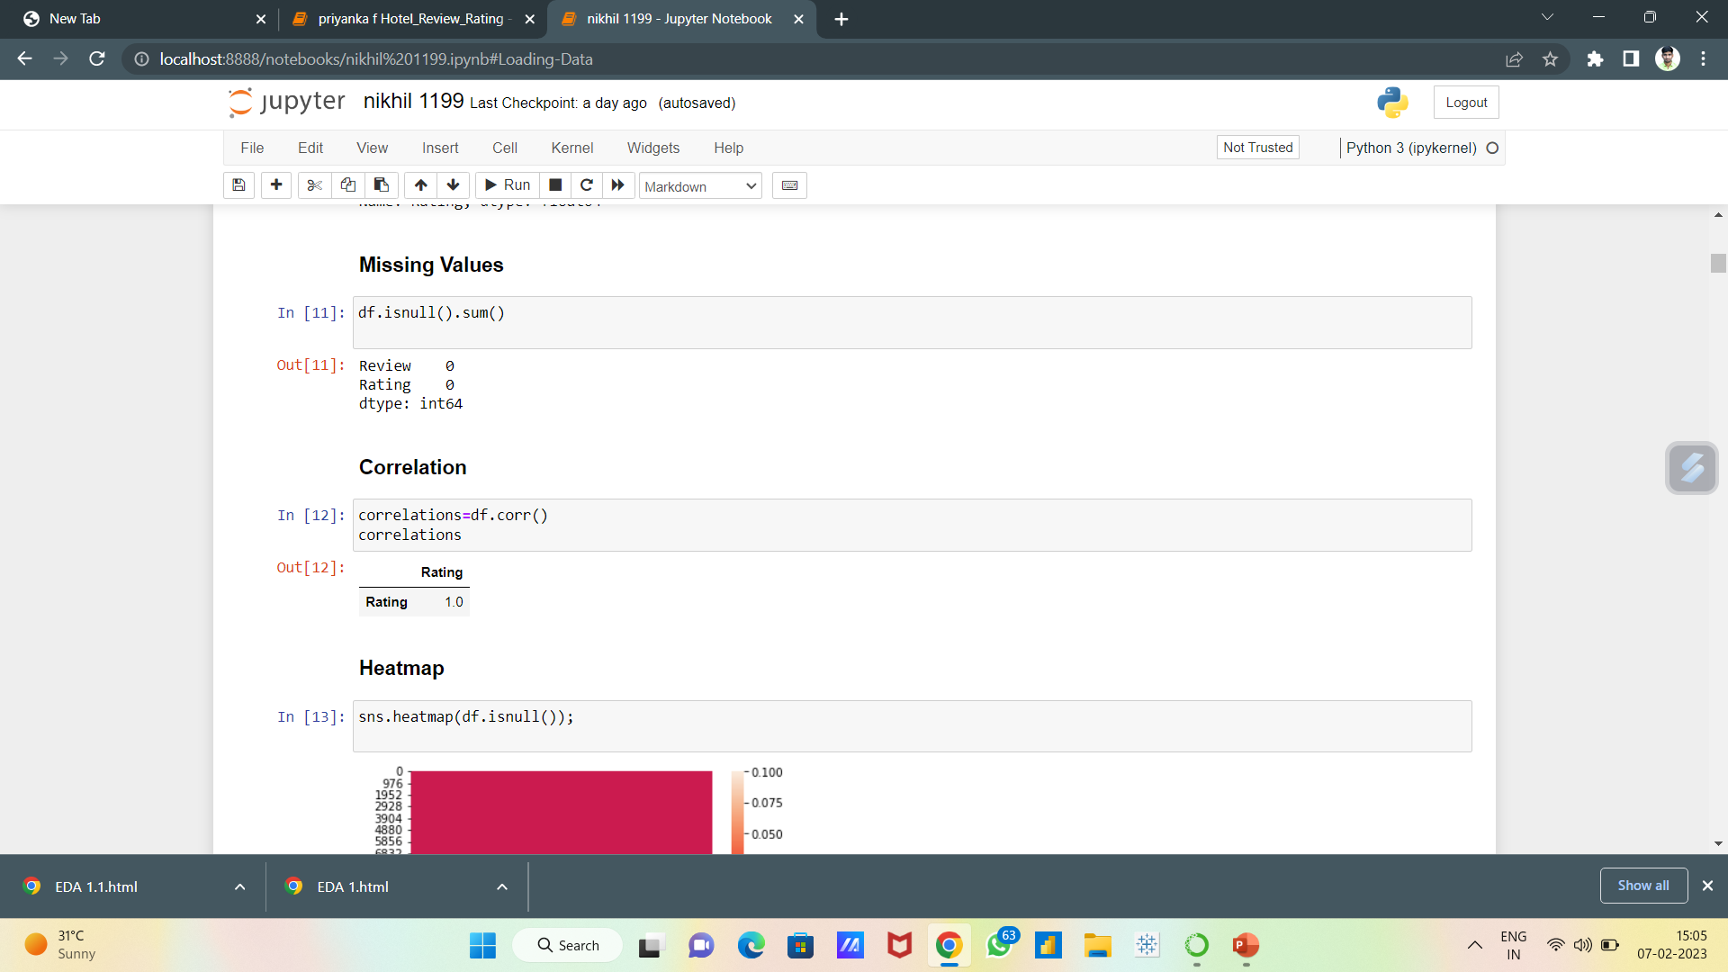
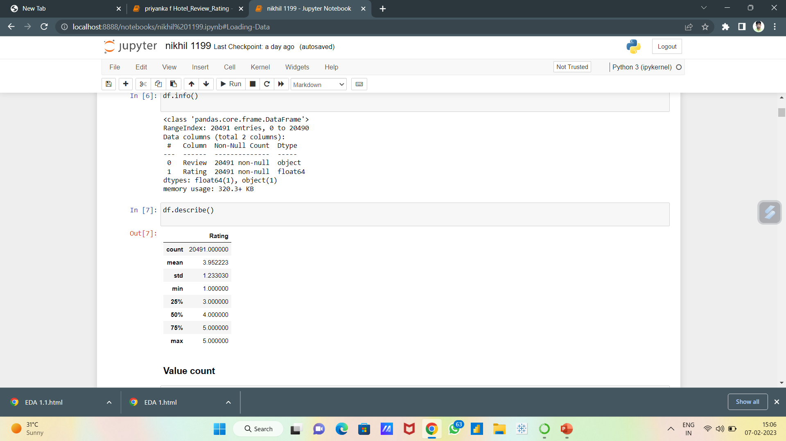
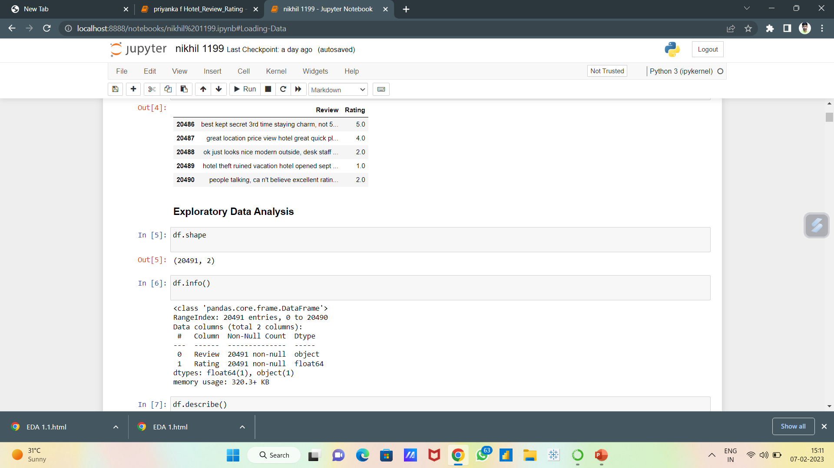
Exploratory Data Analysis (EDA)
Is Null Value Present?
Describe The Data
Shape

Slide 8

Data Visualizations

Slide 9
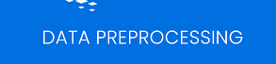
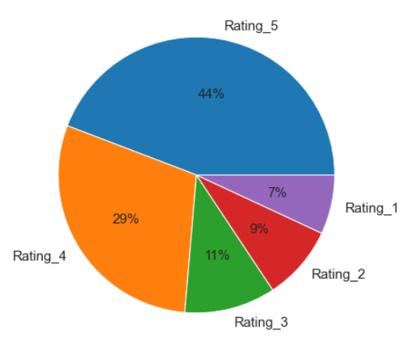
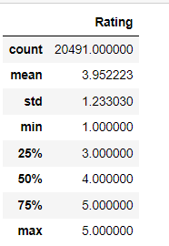
Here as we see 4 and 5 rating are contributing nearly 75% which shows biased towards positive side.

Slide 10
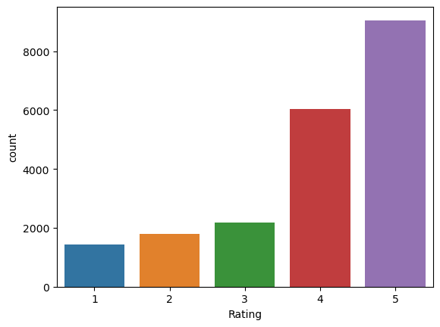
From above visual, we can say that count of ratings for 4, 5 are comparatively much higher than the other rating scores.
Hence, we can say for our data that most of the users are highly satisfied with their experience at hotels.

Slide 11
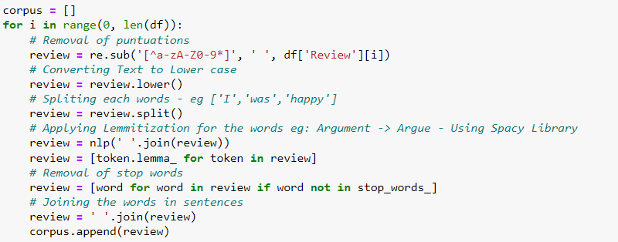
STEPS FOR DATA CLEANING
Remove Punctuation
Case change
Tokenization
Removing stop words

Slide 12
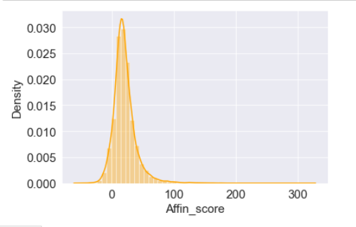
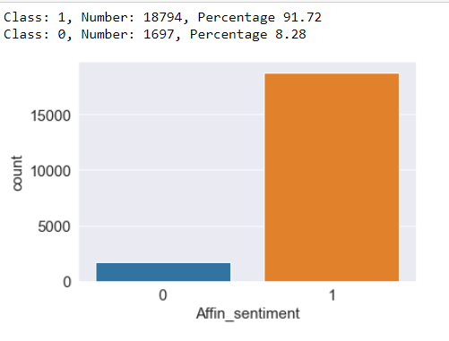
Affine Sentiment Analysis
Afinn is the simplest yet popular lexicons used for sentiment analysis developed by Finn Årup Nielsen. It contains 3300+ words with a polarity score associated with each word. In python
From above graph we can conclude our dataset is biased towards positive side and positive sentiment percentage is 91.72 and for negative sentiment percentage is 8.28

Slide 13
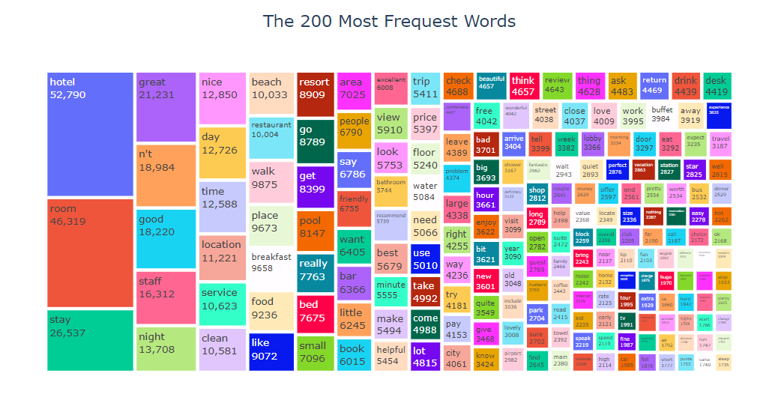
Data Visualization
Based on the Tree map above, all of the words are unique words and there are no stop words in this set. Most words are 'hotel', 'room' and 'stay'. Due to the fact that we are dealing with a hotel review dataset, it make sense.

Slide 14

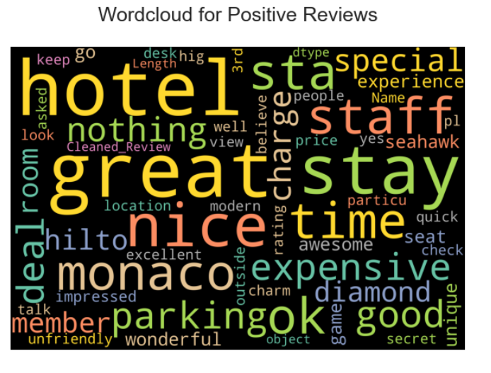
Word Cloud: Positive Reviews

Slide 15
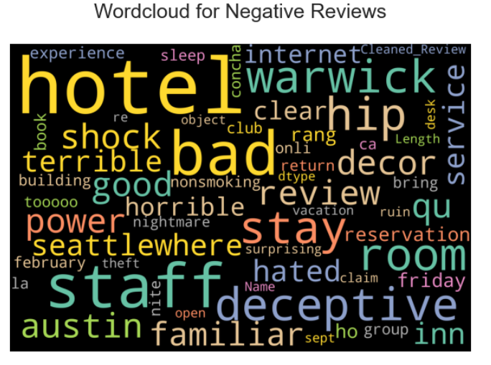
Word Cloud: Negative Reviews

Slide 16
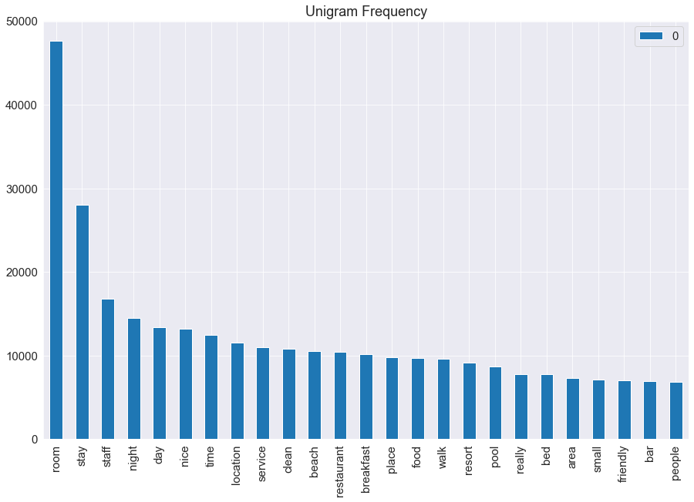
Term Frequency with Countvectorizer
CountVectorizer is breaking down a sentence or any text into words by performing preprocessing tasks like converting all words to lowercase, thus removing special characters
Unigram Frequency

Slide 17
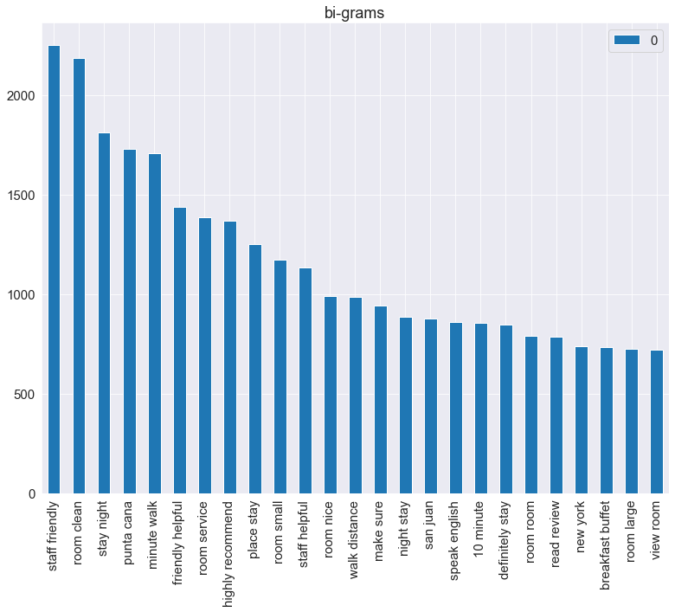
In the Bigram Language Model, we find bigrams, which are two words coming together in the corpus(the entire collection of words/sentences).
BI- GRAM

Slide 18
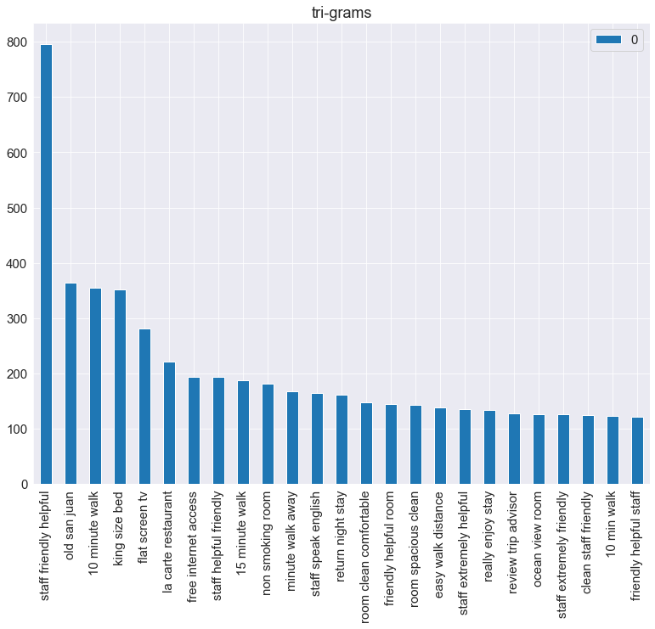
A bigram model approximates the probability of a word given all the previous words by using only the conditional probability of the preceding words while a trigram model looks two words into the past.
TRI - GRAM

Slide 19
Term Frequency with TFIDF
Term Frequency-Inverse Document Frequency
Term Frequency Inverse Document Frequency (TF-IDF) performed better than the word count vectorization method. Similarly to how it happened with the word count method, the accuracy rate of all classifiers improved when the number of target values decreased. The best accuracy score for five categories was Support Vector Machine with a 62% accuracy rate after tuning the parameters. For three categories, the classifier with higher accuracy score was Logistic Regression with a 78% accuracy rate after tuning the parameters. Finally, the classifier Support Vector Machine with binary classification achieved the best performance with 87% of accuracy rate after tuning the parameters.

Slide 20
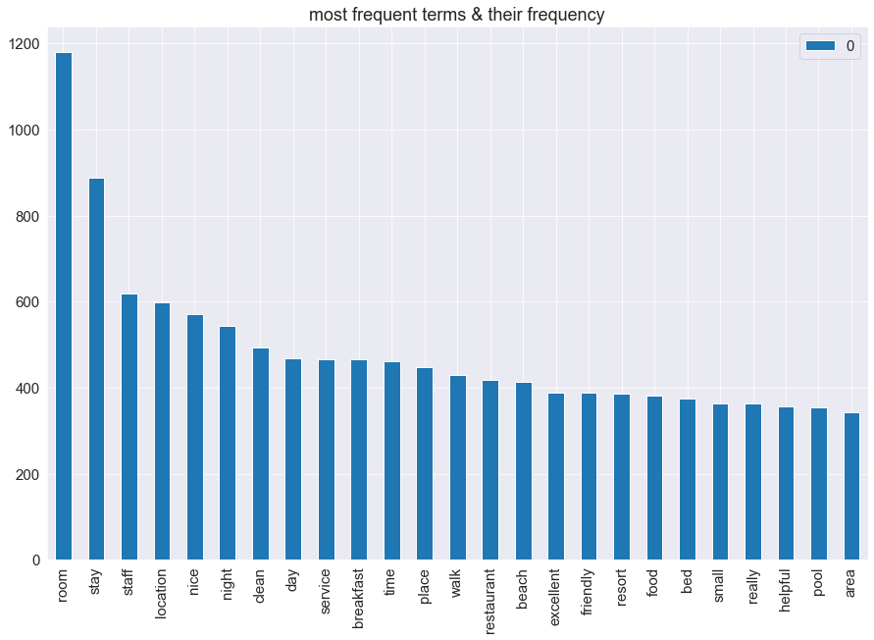
Term Frequency with TFIDF

Slide 21
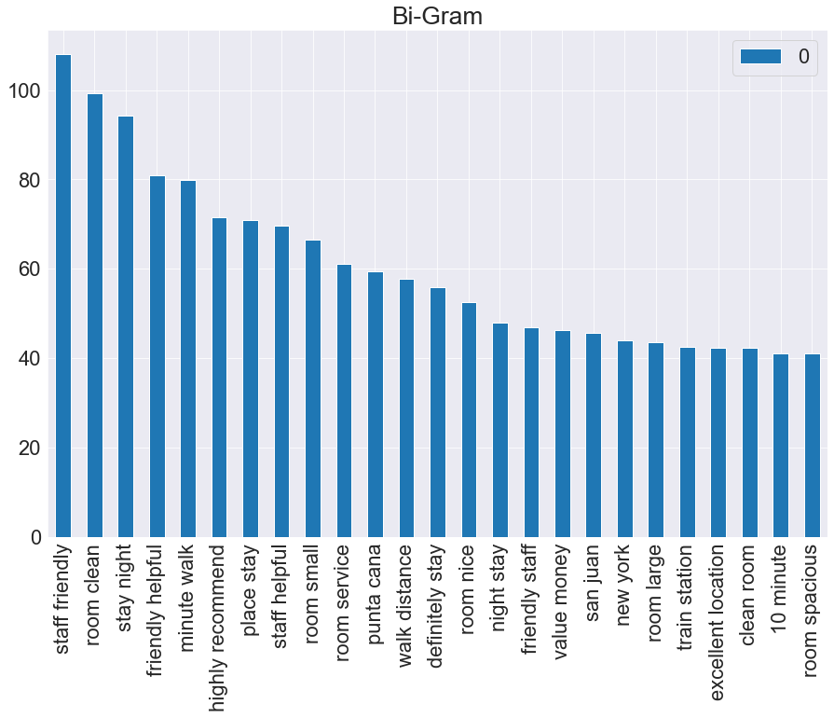
In the Bigram Language Model, we find bigrams, which are two words coming together in the corpus(the entire collection of words/sentences).

Slide 22
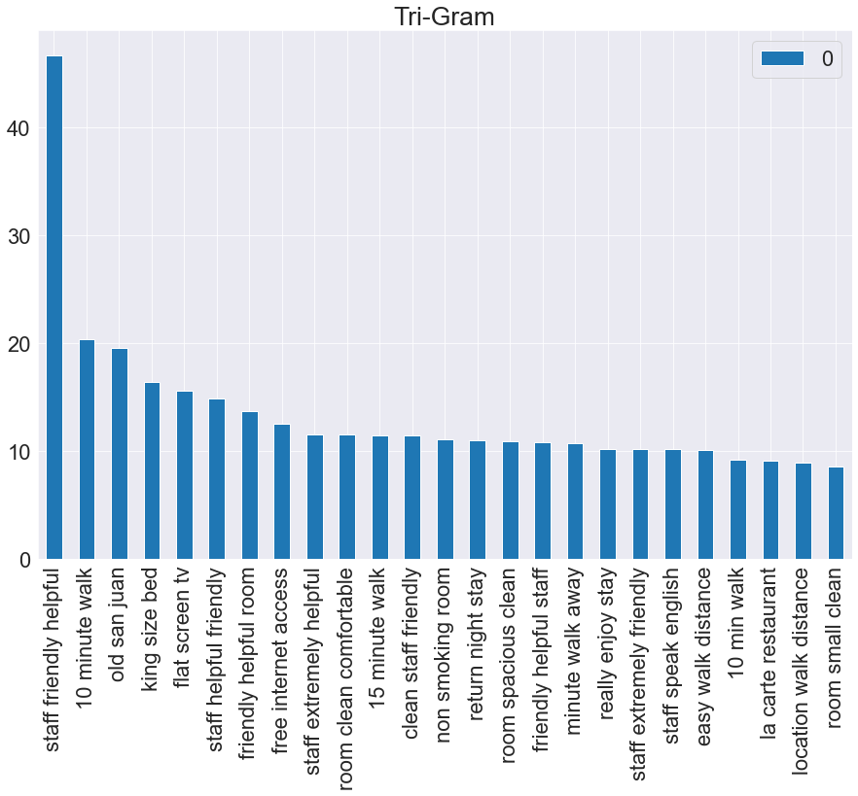
A bigram model approximates the probability of a word given all the previous words by using only the conditional probability of the preceding words while a trigram model looks two words into the past.

Slide 23
Feature extraction Using TFIDF
Feature extraction for machine learning and deep learning. Feature extraction refers to the process of transforming raw data into numerical features that can be processed while preserving the information in the original data set. It yields better results than applying machine learning directly to the raw data.
The concept TF-IDF stands for term frequency-inverse document frequency. This is in the field of numerical statistics. With this concept, we will be able to decide how important a word is to a given document in the present dataset or corpus.

Slide 24
CountVectorizer
Attribute:
feel home 0.154
make feel 0.143
tuck sheet 0.132
theather pike 0.132
street theather 0.132
staff quickly 0.132
square access 0.132
soiled sheet 0.132
soil sheet 0.132
shopping play 0.132
CountVectorizer means breaking down a sentence or any text into words by performing preprocessing tasks like converting all words to lowercase, thus removing special characters. In NLP models can't understand textual data they only accept numbers, so this textual data needs to be vectorized.

Slide 25
TFIDG
Attribute:
wifi complimentary 0.285
touch goldfish 0.285
print robe 0.285
goldfish leopard 0.285
complaint wifi 0.285
location library 0.263
library service 0.263
robe complaint 0.247
leopard print 0.247
quick business 0.227
TF-IDF (Term Frequency - Inverse Document Frequency)
is a handy algorithm that uses the frequency of words to determine how relevant those words are to a given document. It's a relatively simple but intuitive approach to weighting words, allowing it to act as a great jumping off point for a variety of tasks.

Slide 26
MODEL EVEALUATION
Logistic Regression
Gaussian NB
K-Nearest Neighbour
Random Forest

Slide 27
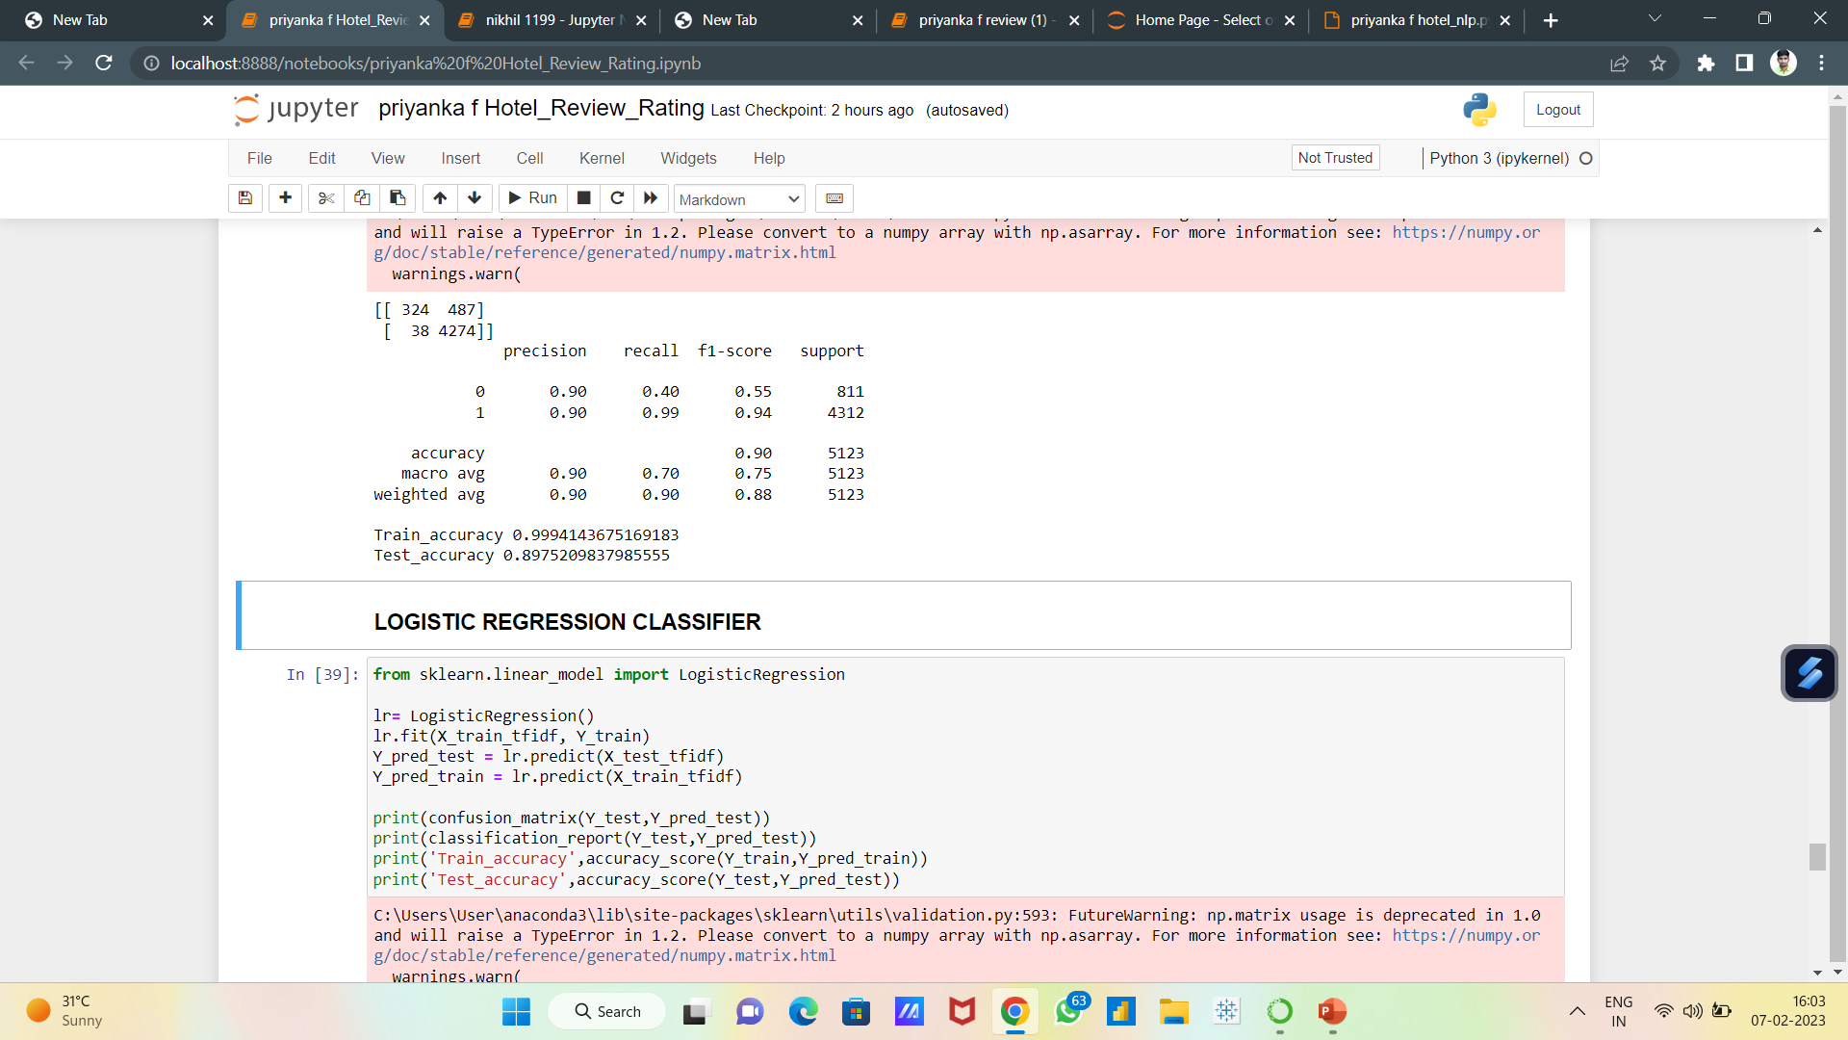
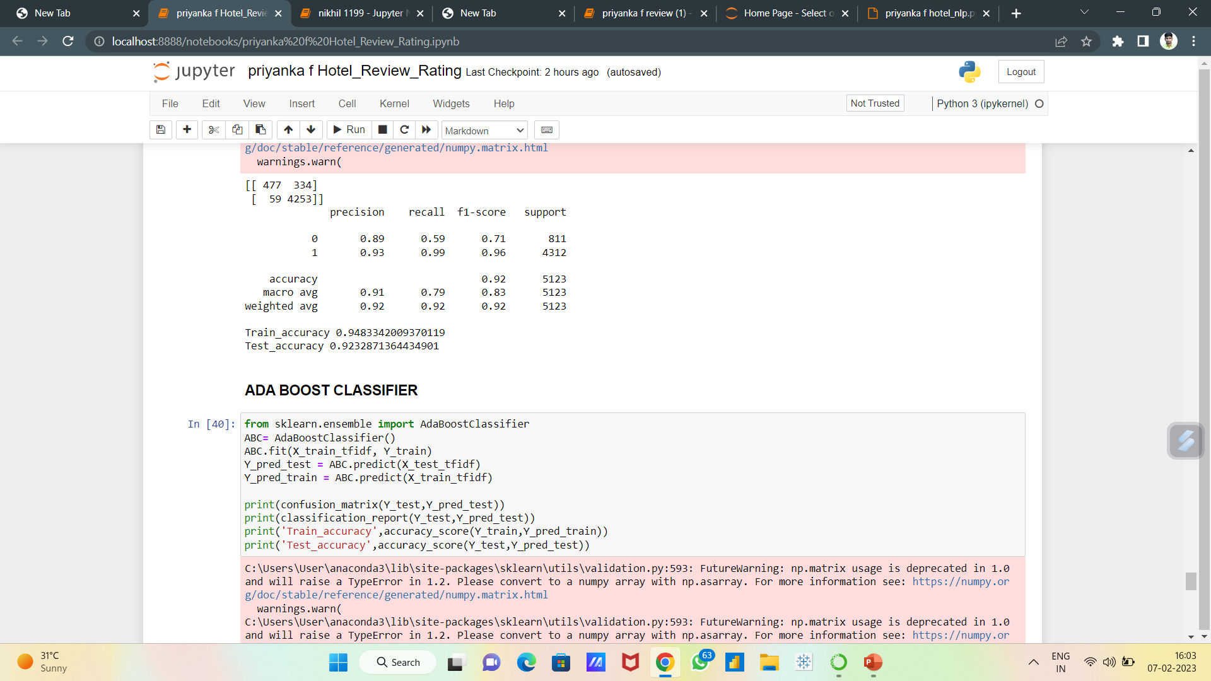
Logistic Regression
A statistical method that is used for building machine learning models where the dependent variable is dichotomous: i.e. binary. Logistic regression is used to describe data and the relationship between one dependent variable and one or more independent variables

Slide 28
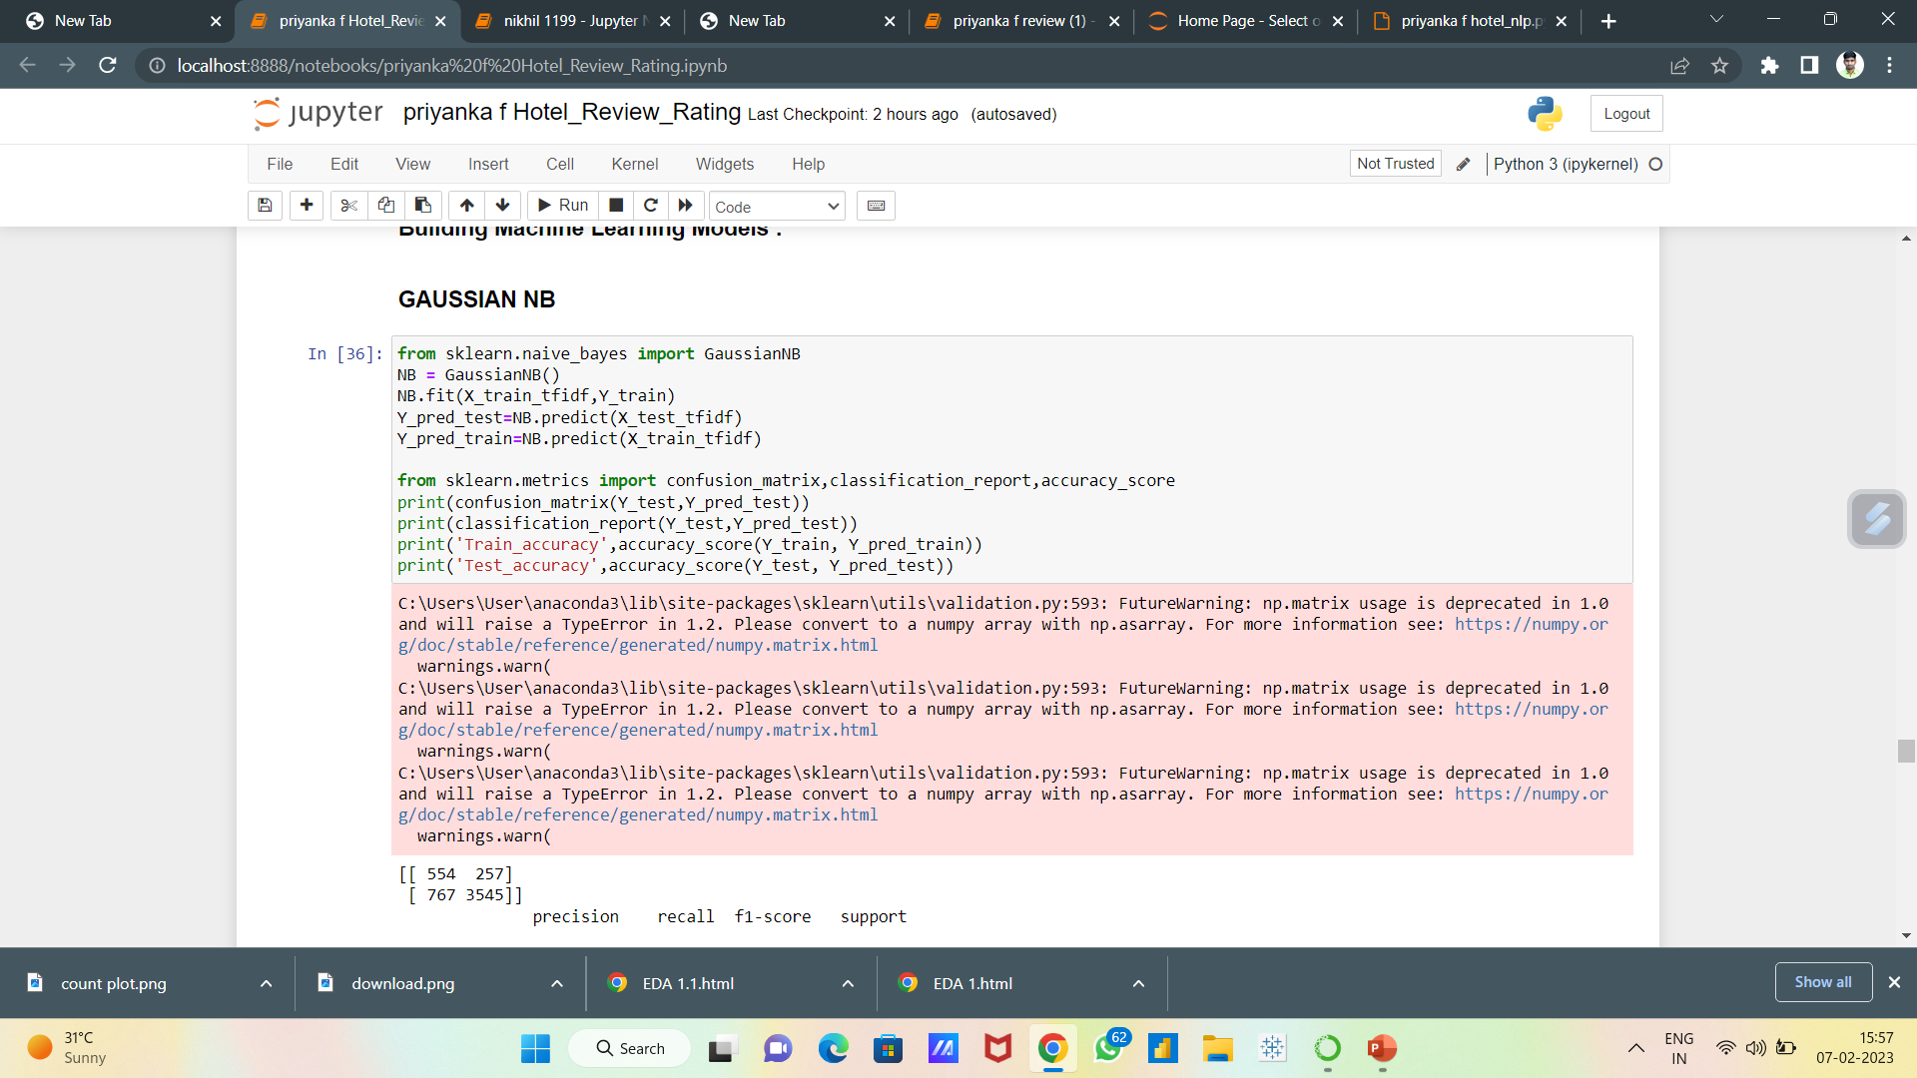
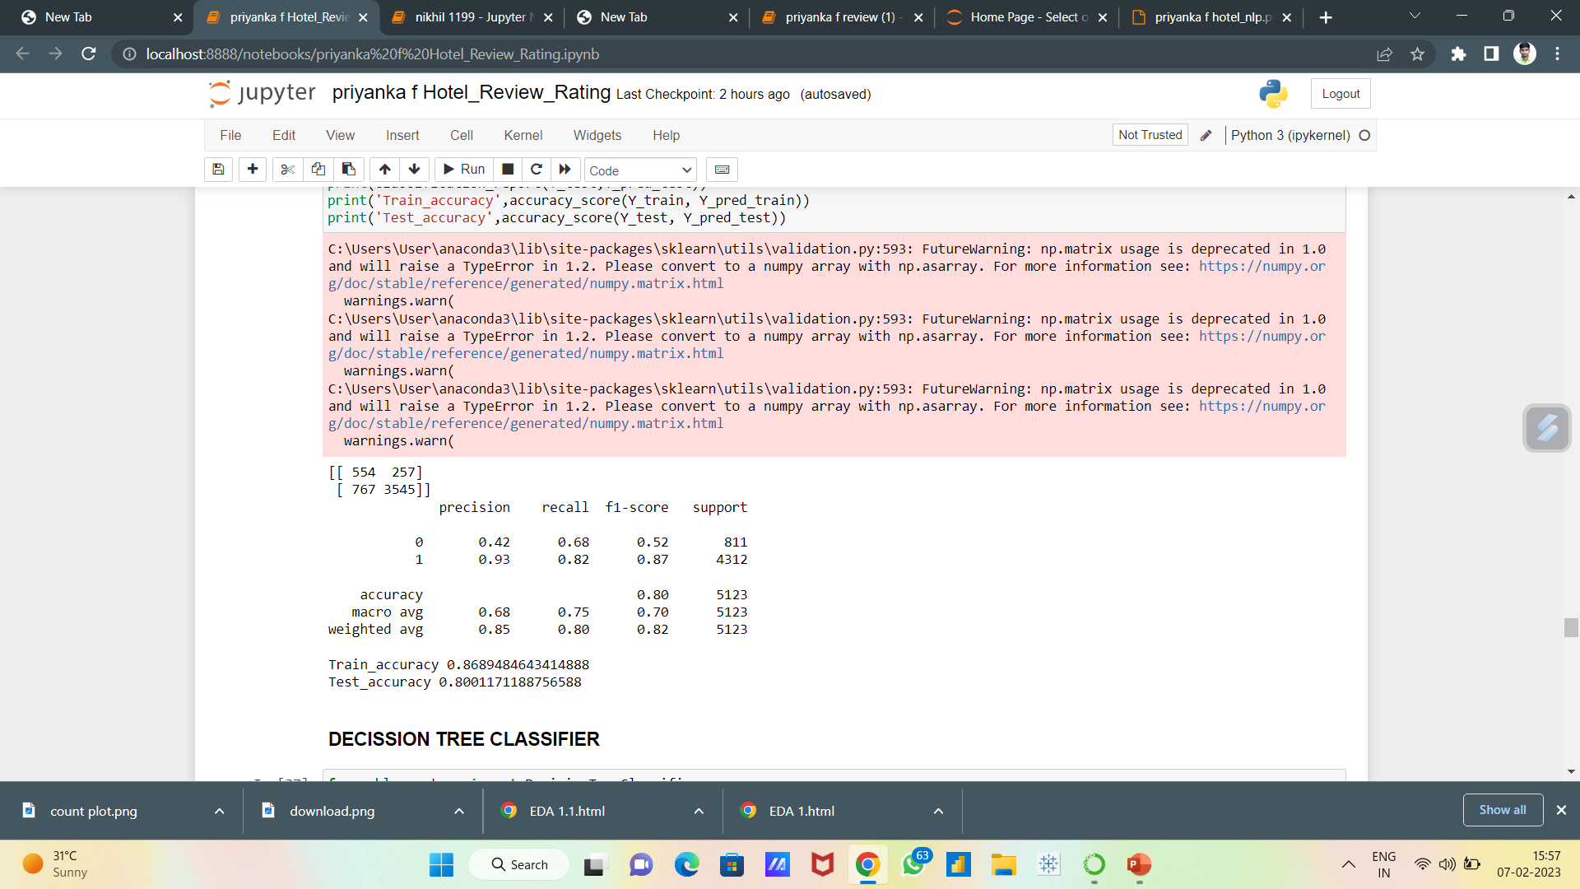
GAUSSIAN NB
Gaussian Naïve Bayes is a simple learning algorithm that utilizes Bayes rule together with a strong assumption that the attributes are conditionally independent, given the class. While this independence assumption is often violated in practice, naïve Bayes nonetheless often delivers competitive classification accuracy.

Slide 29
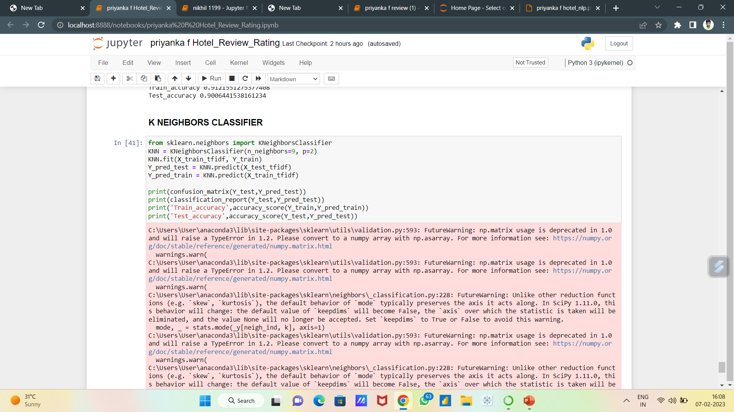
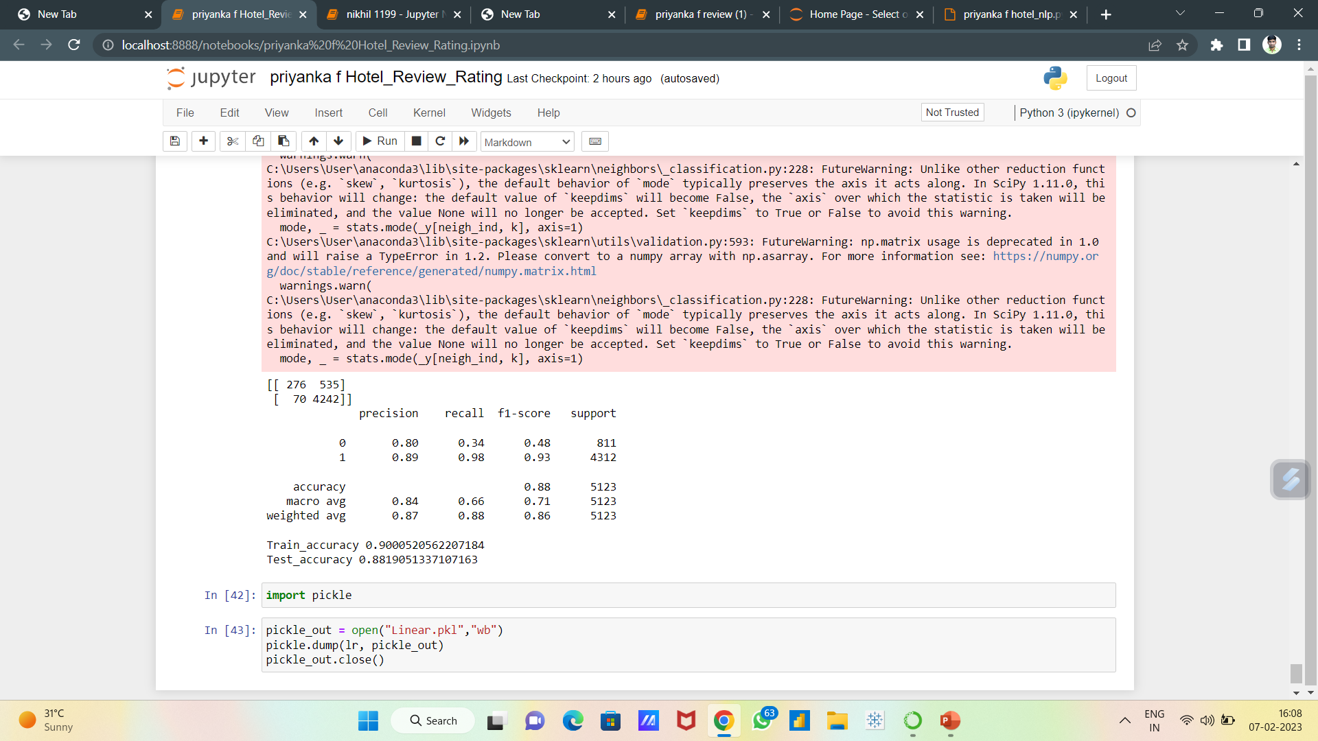
K-Nearest Neighbour
The k-nearest neighbors algorithm, also known as KNN or k-NN, is a non-parametric, supervised learning classifier, which uses proximity to make classifications or predictions about the grouping of an individual data point.

Slide 30
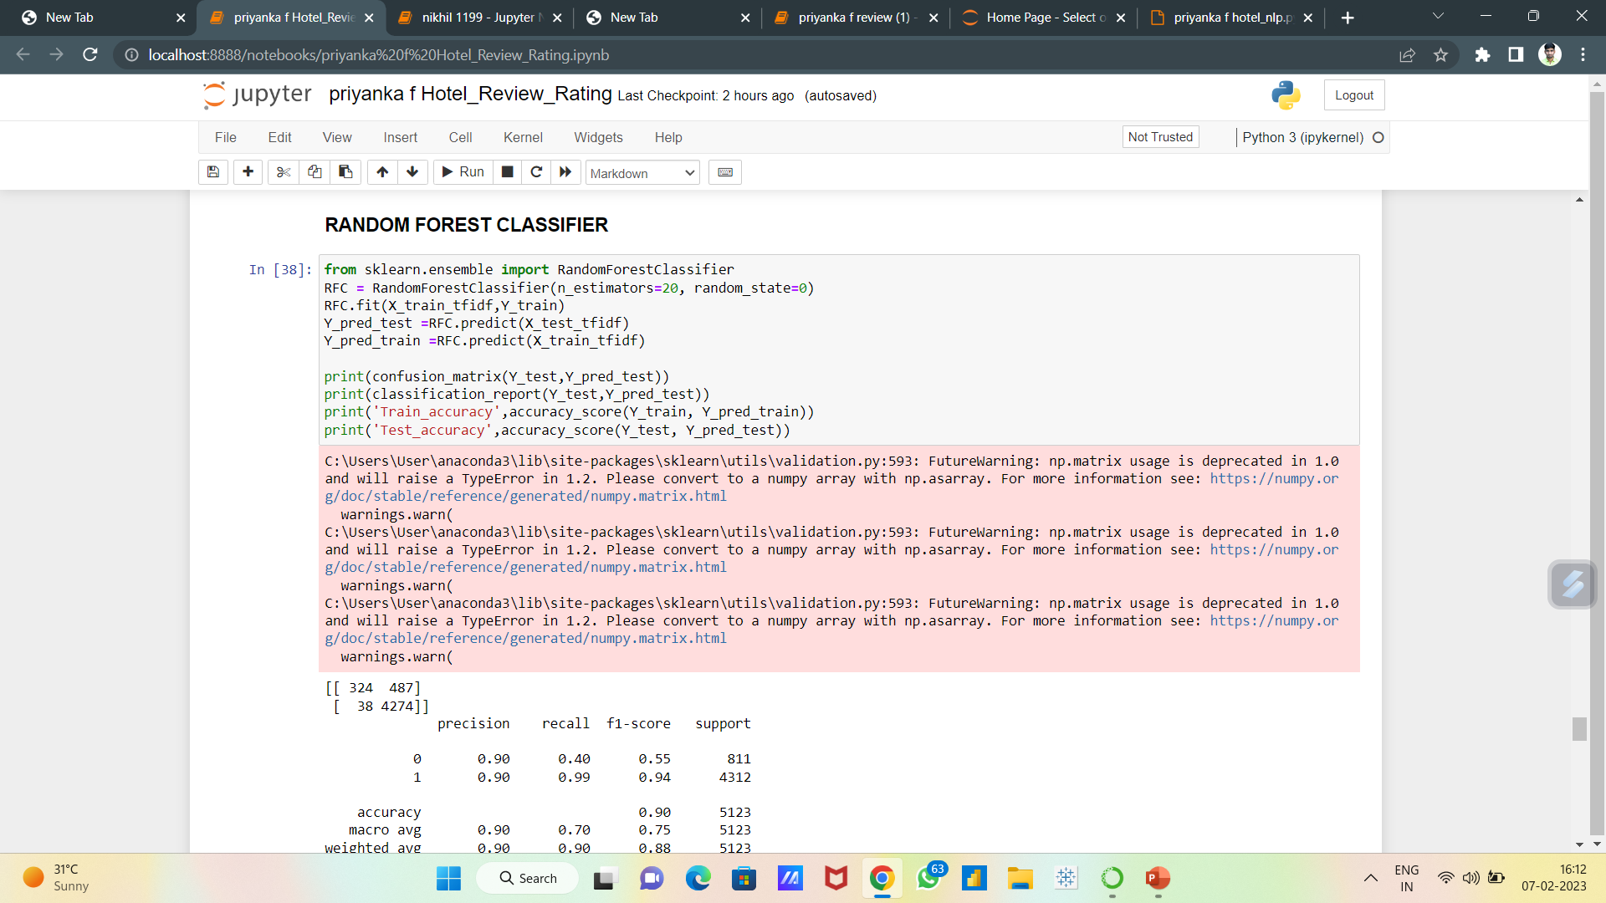
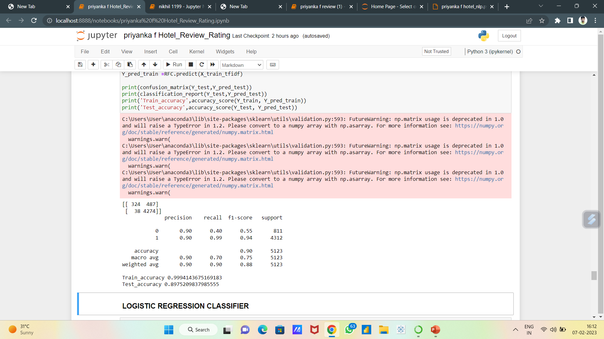
Random Forest
Random forest is an ensemble method which creates a number of decision trees turned into an
ensembled forest. Since random forest is an ensemble method, it randomly selects features to be
used in each step for training while forming the decision trees. Random forest forms a set of decision
trees instead of one tree. Each tree in the forest, makes prediction of target class based on the
selected features. Each predicted class gets a vote every time it is predicted. The class with the
highest votes is selected at the end. Random forest is suggested to be a good classiﬁer as it provides
the best performance metrics. It is very suitable for large amount of data.

Slide 31
Finalizing The Model:
After checking the accuracy of all models we decided to go with the Logistic Regression Model for the deployment
For deployment we need to use streamlit
We built front end of our website using HTML and deployed it on our local machine.

Slide 32
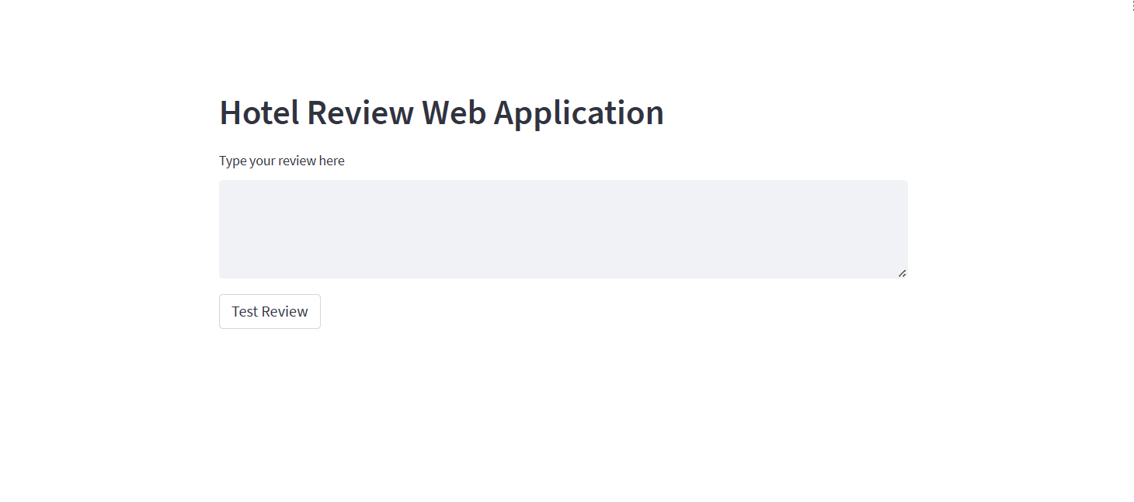
Deployment

Slide 33
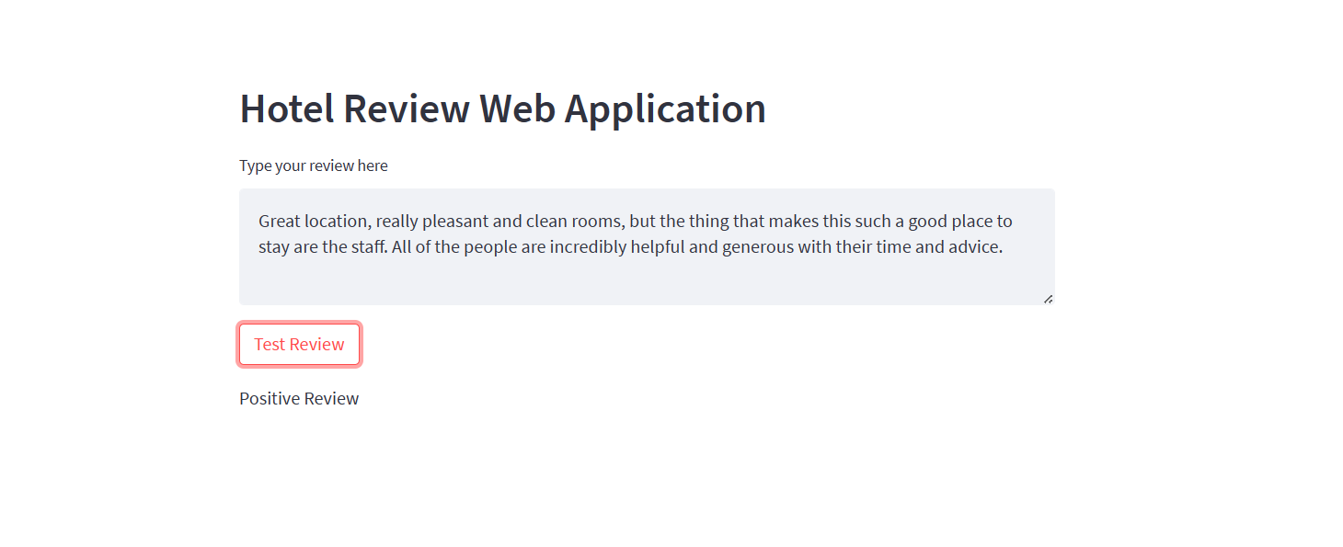
POSITIVE REVIEW

Slide 34
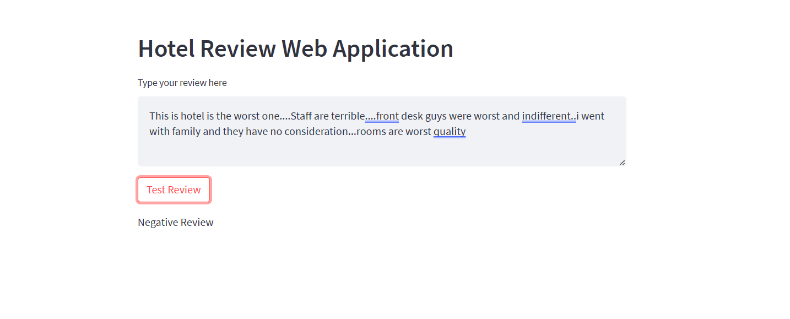
NEGATIVE REVIEW

Slide 35
CHALLENGES FACED
There were large number of values
Positive number reviews are more.
So, it was difficult to predict negative reviews.
As NLP project the conversion from text to vectors and cleaning process extraction was an hectic

Slide 36
CONCLUSION
On the basis of precision, recall, accuracy and FI-score, Logistic Regression With appropriate parameter settings, performs the best.
We can observe that both SVM and logistic Regression performs really well as compared to the most complex of these three that is Random Forest.
So we will choose Logistic Regression Model to Deploy.
It will be interesting to use such a method for sentiment analysis of hotel reviews.

Slide 37


